Slide 1


VIVEKANAND COLLEGE FOR ADVANCED COMPUTER AND INFORMATION SCIENCE
Affiliated to
VEER NARMAD SOUTH GUJARAT UNIVERSITY, SURAT
MINI PROJECT REPORT
ON
“Global Mental Health & Lifestyle Survey”
As a partial Requirement for Degree
Of
BACHELOR OF COMPUTER APPLICATION (BCA)
Guided By : Mrs. Ankita Patel
Submitted By :
Patel Tanvikumari Bharatbhai ( 9655)
Patel Visa Dipakbhai ( 9660)

Slide 2

ACKNOWLEDGEMENT
We sincerely thank our project guide, Mrs. Ankita patel ,for her valuable guidance and support.
We are also greatful to our principlal ,Dr.Sandip Surati ,and campus Director, Mrs. Sumathi Shenoy, for their support and resources.
Lastly, we thank our parents, friends and faculty for their encouragement.

Slide 3
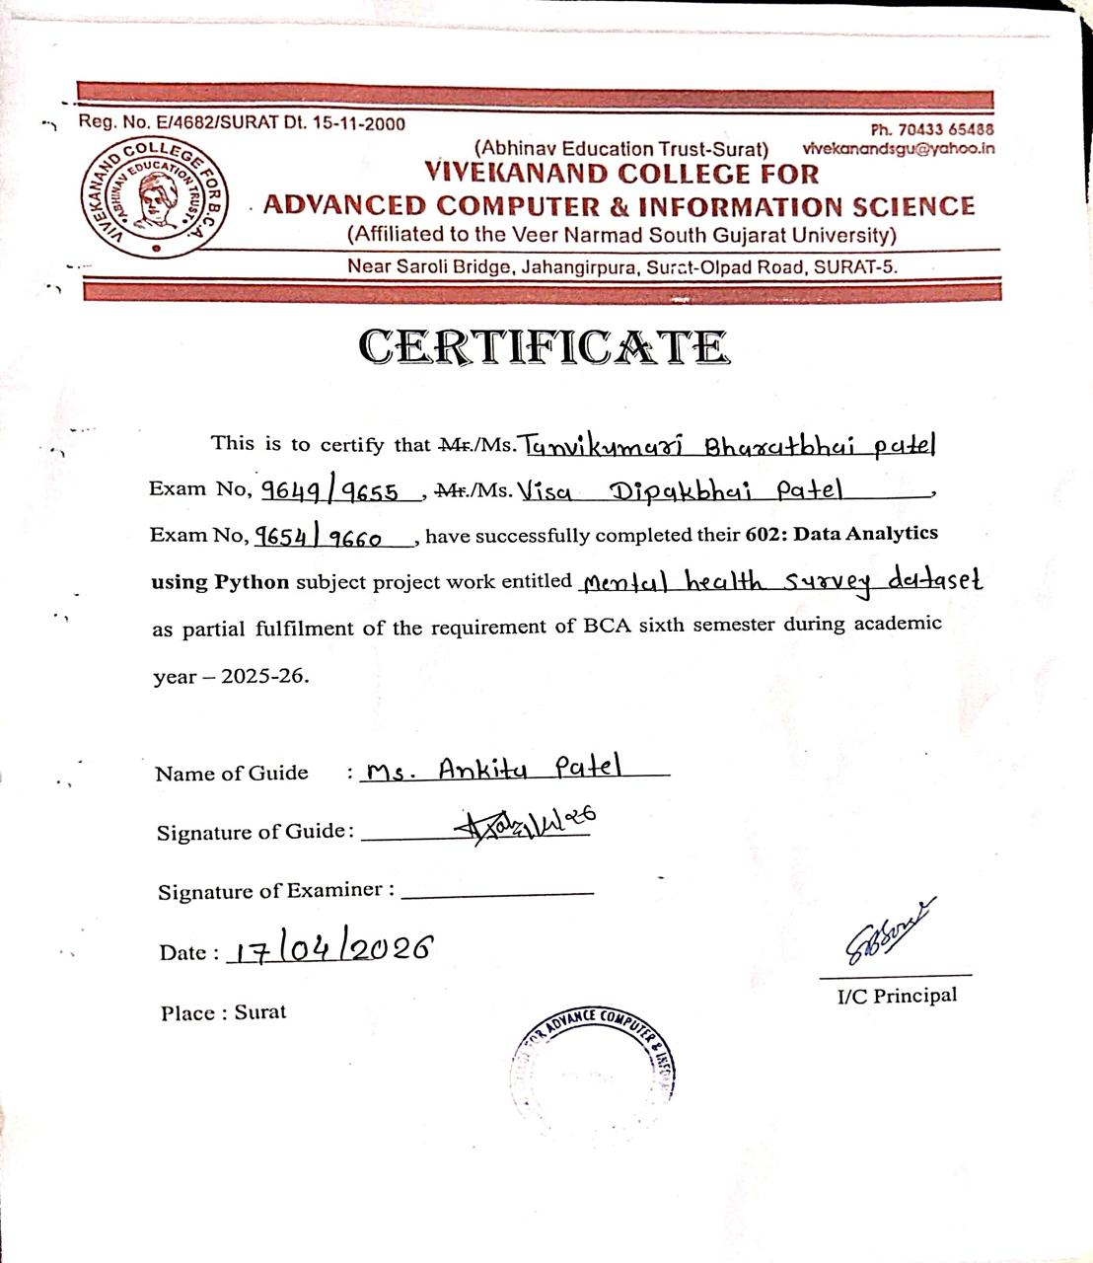


Slide 4

INTRODUCTION TO MENTAL HEALTH AS A GLOBAL CONCERN
Mental health disorders affect 1 in 4 people globally, making it one of the leading causes of disability worldwide. Our lifestyle choices—including sleep patterns, physical activity, and social connections—play a crucial role in shaping our mental well-being.

Slide 5

PROJECT OBJECTIVES
01
Conduct comprehensive Exploratory Data Analysis (EDA) to understand data patterns and distributions.
02
Perform thorough data cleaning to handle missing values, outliers, and ensure data quality.
03
Create meaningful visualizations to communicate insights about mental health and lifestyle correlations.
04
Build predictive models using machine learning to generate actionable mental health insights.

Slide 6




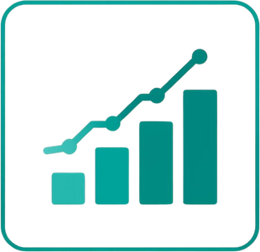

PROJECT PURPOSE AND TOOLS
01
02
03
Analyze the relationship between lifestyle habits and mental health indicators using data-driven approaches.
Utilize Python programming for data processing, statistical analysis, and visualization of survey results.
Apply machine learning algorithms to identify patterns and predict mental health outcomes.

Slide 7

DATA SOURCE OVERVIEW
The dataset is sourced from Kaggle, containing comprehensive mental health and lifestyle survey responses. It includes demographic information, lifestyle habits, and mental health indicators in CSV format, enabling thorough exploratory data analysis.

Slide 8

DATASET FEATURES
01
Age: Captures participant age ranges to analyze how mental health patterns vary across different life stages and generations.
02
Gender & Occupation: Demographic identifiers that help examine mental health disparities across different groups and work environments.

Slide 9


03
DATASET FEATURES
Sleep & Physical Activity
Sleep Hours measures daily rest duration. Physical Activity Level tracks exercise frequency and intensity patterns.
04
Stress Indicators
Work Stress and Social Isolation scores capture environmental and relational stressors affecting mental wellness.
05
Mental Health Scores
Anxiety and Depression scores provide direct mental health measurements for predictive modeling analysis.

Slide 10

DOMAIN EXPLANATION: MENTAL HEALTH & LIFESTYLE ANALYSIS
This project falls under the domain of “Mental Health And Lifestyle Analysis” , which focuses on studying how daily habits and personal behaviour impact and individual’s mental well-being. It combines concepts from healthcare , physiology and data analytics to understand issues like stress, anxiety and depression.

Slide 11

MODE OF PROJECT & WORK DISTRIBUTION
Group Project : 2 Members
Data Analysis & Exploratory Data Analysis
Machine Learning models & Visualization
Joint review, documentation & presentation
Python-based analysis with scikit-learn

Slide 12

PYTHON TOOLS & LIBRARIES
1
NumPy: Provides powerful numerical computing capabilities for array operations, mathematical functions, and efficient data manipulation essential for handling large datasets.
2
Pandas: Offers data structures like DataFrame for organizing, cleaning, filtering, and analyzing structured data with intuitive syntax and built-in functions.

Slide 13


Matplotlib
Seaborn
R2 Score
Foundation library for creating static, animated, and interactive visualizations.
Statistical data visualization library built on Matplotlib with attractive defaults.
It is a metric used to evaluate regression models.
PYTHON TOOLS & LIBRARIES
Scikit-learn
Train_Test_Split
Evaluation Metrics
Comprehensive ML library for classification, regression, and clustering algorithms.
Splits datasets into training and testing subsets for model validation.
Accuracy, precision, recall, F1-score measure model performance.

Slide 14






PYTHON TOOLS & LIBRARIES
Linear Regression
Multiple Linear Regression
Logistic Regression
Linear regression is a basic machine learning algorithm used for predicsion.
Multiple Linear Regression is an advanced version of Linear Regression.
Logistic Regression is used for classification problems.

Slide 15
PROJECT TASKS OVERVIEW
01
02
03
Begin with exploratory data analysis using EDA.ipynb to understand data patterns, distributions, and relationships.
Apply simple and multiple linear regression models to analyze relationships between lifestyle factors and mental health indicators.
Implement logistic regression for classification tasks to predict mental health outcomes based on lifestyle variables.

Slide 16

EXPLORATORY DATA ANALYSIS PROCESS
01
Data Loading & Inspection: Import the dataset using Pandas, examine structure with .head(), .info(), and .shape() to understand data types and dimensions.
02
Summary Statistics: Generate descriptive statistics using .describe() to analyze mean, median, standard deviation, and distribution of numerical features.

Slide 17

EXPLORATORY DATA ANALYSIS PROCESS
03
Missing Value Detection: Identify and handle null or incomplete data entries using pandas isnull() and dropna() functions to ensure data integrity.
04
Correlation Analysis: Calculate relationships between lifestyle factors and mental health indicators using correlation matrices and heatmaps.

Slide 18


EDA VISUALIZATIONS
Bar Charts
Compare categorical variables like gender distribution, employment status, and mental health conditions across groups.
Histograms
Visualize continuous data distributions such as age spread, sleep hours, and stress levels among participants.
Scatter Plots
Explore relationships between variables like sleep hours vs. work stress to identify potential correlations.

Slide 19

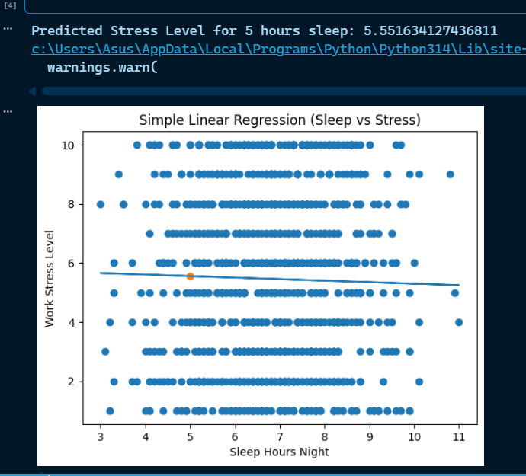
SIMPLE LINEAR REGRESSION MODEL
For the Simple Linear Regression model, the relationship between Sleep Hours and Work Stress Level was analyzed. The model attempted to capture the relationship between these variables; however, the very low R² score indicates that there is no strong linear relationship between them. The predicted values were visualized using a regression line, which helps in understanding the trend, but the model does not provide accurate predictions due to weak correlation.

Slide 20

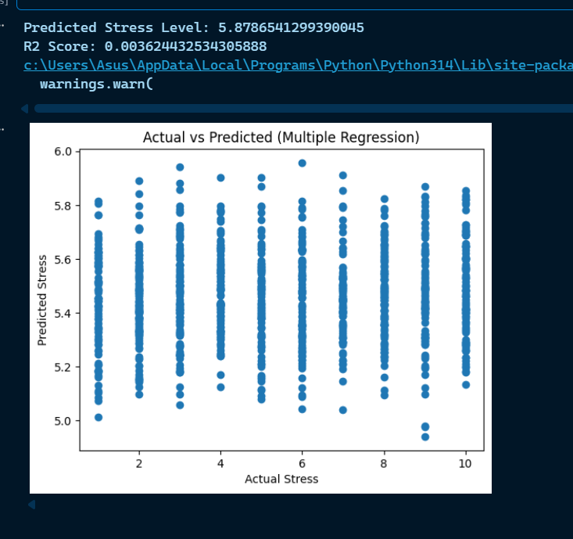
MULTIPLE LINEAR REGRESSION MODEL
For the Multiple Linear Regression model, performance was evaluated using the R² Score. This model used multiple input features such as sleep hours, work hours, screen time, and social media usage to predict stress levels. Although multiple factors were considered, the R² score remained very low, indicating that these variables are not sufficient to explain the variation in stress levels. An Actual vs Predicted scatter plot was also created to visually compare the model’s predictions with actual values.

Slide 21

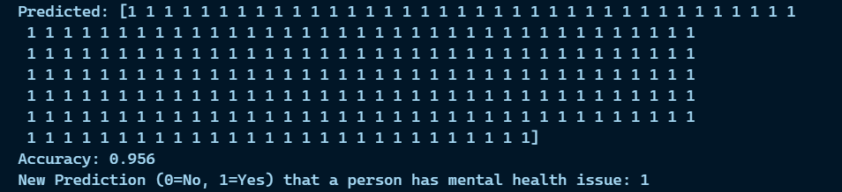
LOGISTIC REGRESSION MODEL
For the Logistic Regression model, evaluation was performed using accuracy score. The model was trained to classify whether a person has a mental health issue (0 or 1). After splitting the dataset into training and testing sets, predictions were made and compared with actual values. The model achieved high accuracy, indicating strong performance in classification tasks. This shows that logistic regression is more suitable for this dataset compared to regression models.

Slide 22

MODEL EVALUATION SUMMARY
01
Simple Linear Regression: R² = 0.000587, indicating very weak linear relationship between sleep and stress.
02
Multiple Linear Regression: R² = 0.003624, slight improvement but still limited predictive power.
03
Logistic Regression: 95.6% accuracy, highly effective for mental health classification tasks.
04
Key Conclusion: Classification outperforms regression for this dataset, suggesting categorical analysis is more suitable.

Slide 23

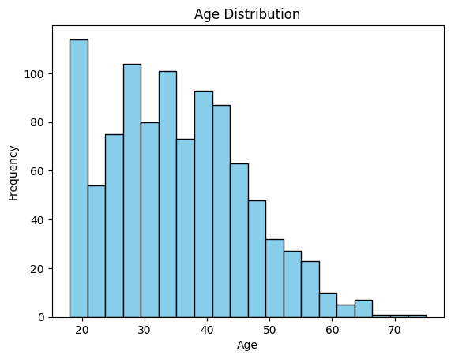
AGE DISTRIBUTION ANALYSIS
The histogram reveals participant age spread across the dataset, showing concentration in the 25-45 age range. This demographic insight helps contextualize mental health patterns across different life stages.

Slide 24

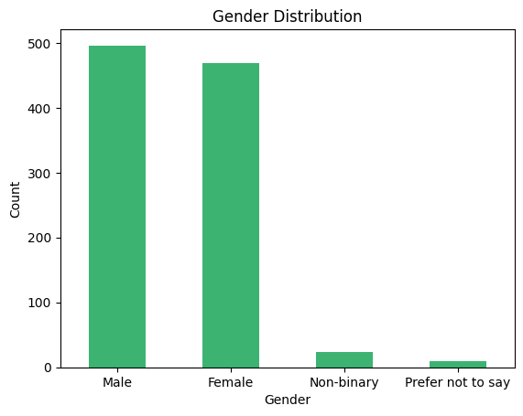
GENDER DISTRIBUTION
The dataset reveals a balanced gender representation with 52% male and 48% female participants. This distribution ensures unbiased analysis across gender groups when examining mental health patterns and lifestyle factors.

Slide 25

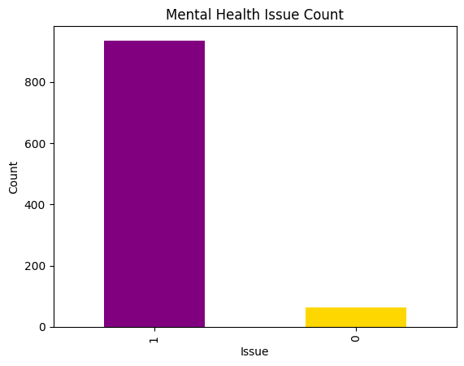
MENTAL HEALTH ISSUE PREVALENCE
Our bar chart analysis reveals a significant portion of survey participants report mental health concerns. The data shows a clear divide between affected and unaffected individuals, highlighting the widespread nature of mental health challenges across demographics.

Slide 26

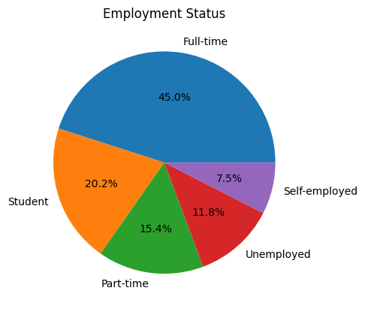
EMPLOYMENT STATUS
Employment status significantly influences mental health outcomes. Our analysis reveals distinct patterns across employed, unemployed, student, and self-employed categories, highlighting the impact of work stability on psychological well-being.

Slide 27
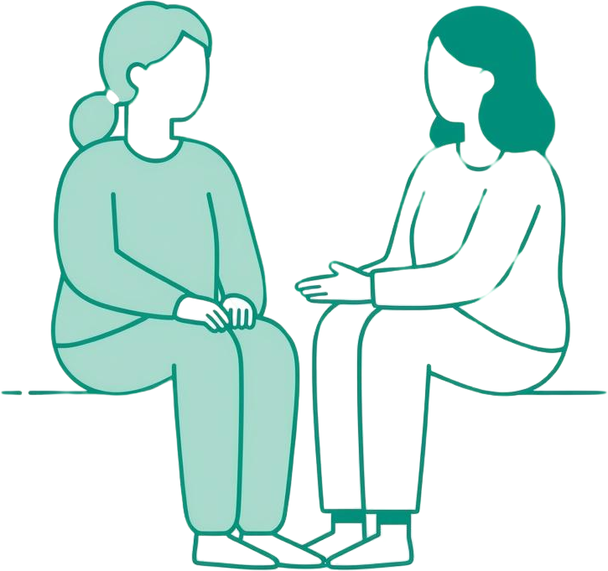
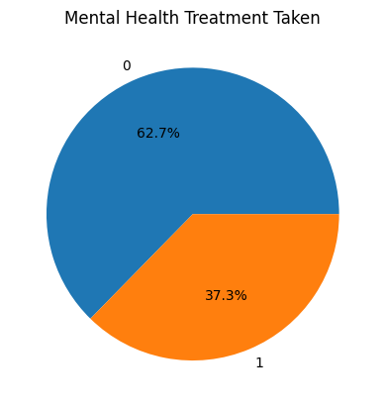
MENTAL HEALTH TREATMENT SEEKING BEHAVIOR
Analysis reveals critical insights into help-seeking patterns: awareness of mental health resources and willingness to pursue treatment vary significantly across demographics, highlighting the need for targeted outreach programs.

Slide 28

KEY INSIGHT: REGRESSION MODEL LIMITATIONS
01
Simple Linear Regression yielded R² = 0.000587, indicating virtually no linear relationship between Sleep Hours and Work Stress.
02
Multiple Linear Regression improved only marginally to R² = 0.003624, suggesting lifestyle factors have complex, non-linear interactions with mental health outcomes.

Slide 29

KEY INSIGHT: LOGISTIC REGRESSION STRENGTH
The logistic regression model achieved an impressive 95.6% classification accuracy, demonstrating strong predictive capability for mental health outcomes. This high accuracy validates the model's effectiveness for binary classification tasks in mental health analytics.

Slide 30

CONCLUSION AND KEY FINDINGS
The study successfully meets its objectives by producing scientifically valid data. Logistic regression achieved 95.6% accuracy in classifying mental health outcomes, while linear models revealed complex, non-linear relationships between lifestyle factors and mental well-being. Further research is recommended with broader methods and variables.

Slide 31


ACKNOWLEDGEMENT RECAP
Project Guide
Sincere thanks to our guide for invaluable mentorship and continuous support throughout this journey.
Faculty & Institution
Grateful to the Principal, Campus Director, and faculty of Vivekanand College for their encouragement.
Family & Friends
Heartfelt appreciation to our parents and friends for their unwavering motivation and belief in us.

Slide 32







QUESTIONS & DISCUSSION
We welcome your questions, feedback, and insights about our mental health and lifestyle analysis project. Your perspectives help deepen our understanding and drive meaningful conversations about data-driven approaches to well-being.

Slide 33

CONTACT INFORMATION
For questions, collaborations, or further discussion about this research project, please reach out through the following channels:
Department: Computer Science & Data Analytics
Institution: Vivekanand College

Slide 34
THANK YOU
Thank you for your attention.

